Slide 1
Reducing Call Centre Operating Costs
Operational Diagnostic & Recommendations
Prepared by Tumelo Kibi Maboea
23/02/2026

Slide 2
Business Context & Objective
ConnectTel observed rising call centre operating costs and commissioned a diagnostic to understand the underlying drivers.
The goal is to identify operational inefficiencies in call handling and workforce management, and to uncover opportunities to reduce costs without negatively impacting customer experience.

Slide 3
Our Approach
Key Operational Factors Considered
Before analysing the data, we identified the factors most likely to be driving inefficiencies and elevated costs.This hypothesis-driven approach focused the analysis on validating key cost drivers.
Long Call Duration
Longer call times increase labour costs and reduce call-handling capacity.
Low First-Call Resolution & High Escalations
Unresolved issues create repeat work and escalate resource usage.
Workforce Experience & Overtime Usage
Experience gaps may reduce efficiency, while overtime raises staffing costs without proportional productivity gains.

Slide 4
Key Questions Guiding the Analysis
To test the identified cost drivers, we translated our hypotheses into the following business questions:
Does longer call duration lead to a higher cost per call?
Are unresolved issues driving escalations and repeat handling?
Do performance differences exist across teams, shifts, or experience levels?
Is overtime contributing disproportionately to operating costs?
Are more experienced agents handling calls more efficiently than less-experienced agents?

Slide 5
How We Used the Data
ANALYTIC FOCUS | METRICS
Efficiency | AvgCallDuration, CallsHandled
Quality | FCRrate, EscalationRate
Workforce | Experience, OvertimeHours
Operations | Team, Shift
Cost Impact | CostPerCall

Slide 6
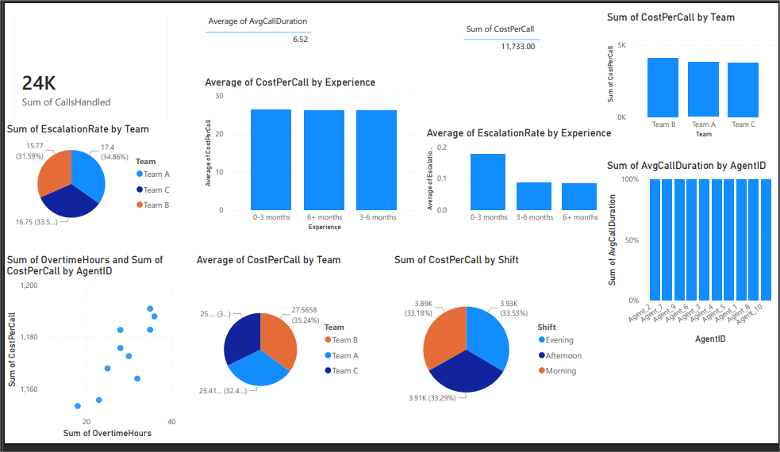
Key Insights from the Analysis

Slide 7
Shift vs. CostPerCall.
The Evening shift has the highest cost per call, indicating lower efficiency compared to other shifts.
Insight:
Cost differences across shifts indicate variations in workforce capability, support, or call handling practices.
2. Team vs. CostPerCall
Team B has the highest cost per call, followed by Team A, while Team C has the lowest.
Insight:
Inefficiencies are concentrated in specific teams rather than across the whole operation.

Slide 8
3. OvertimeHours vs. CostPerCall
Agents with more overtime tend to have higher costs per call.
Insight:
Overtime may be increasing costs due to inefficiencies rather than demand.
4. Experience vs. EscalationRate
Newer agents have the highest escalations, while more experienced agents have fewer.
Insight:
Experience improves issue resolution and reduces the need for escalations.

Slide 9
5. Experience vs CostPerCall
Costs are similar across all experience groups.
Insight:
Experience is not a key driver of cost differences.

Slide 10
High-level, actionable ideas to improve cost
Standardise Call Handling Across Teams and Shifts
Align processes and share best practices to reduce performance differences.
Benefit: Improves efficiency and lowers cost per call.
2. Reduce Reliance on Overtime
Monitor overtime and address productivity gaps through coaching and better workload management.
Benefit: Cuts avoidable labour costs.
Strengthen Support for New Agents
Enhance onboarding and guidance to reduce escalations.
Benefit: Faster issue resolution and improved service quality.

Slide 11
Data Analysed
AvgCallDuration → efficiency
CostPerCall → cost impact
EscalationRate → quality
OvertimeHours → workforce utilisation
Team / Shift / Experience → performance comparison

Slide 12
Risks & Assumptions
Assumptions
Cost differences are mainly driven by internal processes and workforce performance.
Current staffing levels are adequate if efficiency improves.
Risks
Resistance to process changes may slow implementation.
Reducing overtime too quickly could affect service levels.
Training improvements may take time to deliver results.

Slide 13
Thank you

